Slide 1


K.RAMAKRISHNAN COLLEGE OF TECHNOLOGY (AUTONOMOUS), TRICHY
CONTACT MANAGEMENT SYSTEM
PRESENTED BY
2303811724321079
OM PRAKASH M

Slide 2
PRESENTATION OVERVIEW
PROJECT INTRODUCTION
PROBLEM IDENTIFICATION
OBJECTIVE
PROPOSED SYSTEM
ARCHITECTURAL DIAGRAM
MODULES USED
MODULES DESCRIPTION
CONCLUSION

Slide 3
PROJECT INTRODUCTION
The Contact Management System in DBMS is designed to store, organize, and manage contact information such as names, phone numbers, and emails in a database. It aims to provide users with an easy-to-use interface for adding, updating, searching, and deleting contact details. The system leverages a Database Management System to ensure efficient and secure data storage. With the growing need for efficient contact management, this project simplifies the process by automating and centralizing contact information.

Slide 4
PROBLEM IDENTIFICATION
Managing contacts manually can be time-consuming and prone to errors.
Storing contact information across multiple devices or platforms leads to disorganization.
Lack of a centralized system makes it difficult to access and update contact details quickly.
Users face difficulties in searching and sorting contacts efficiently.
Security and privacy concerns arise when contact data is stored in an unorganized or unsecured manner.

Slide 5
OBJECTIVE
The objective of the Contact Management System project is to create an efficient, user-friendly system for managing contact information. The system aims to provide users with the ability to easily store, retrieve, update, and delete contacts from a centralized database. It seeks to simplify the process of searching and organizing contacts by offering robust search and sorting functionalities. Additionally, the system will ensure data security by implementing access control and authentication mechanisms.

Slide 6
PROPOSED SYSTEM
Users can add, edit, delete, and view contact details securely through an intuitive interface.
A centralized database-driven system to store and manage contact information.
The system will include search and sorting features for easy retrieval of contact data.
User authentication and authorization will be implemented to ensure data security.
Contacts will be organized and stored in a structured manner, ensuring consistency and accuracy.

Slide 7
ARCHITECTURAL DIAGRAM
Database system module
User Module
Export Module
Search and sorting module
Import
Module
Admin Module

Slide 8
MODULES USED
User interface module
Database management system module
Search and sorting module
Admin module
Import Module
Export Module

Slide 9
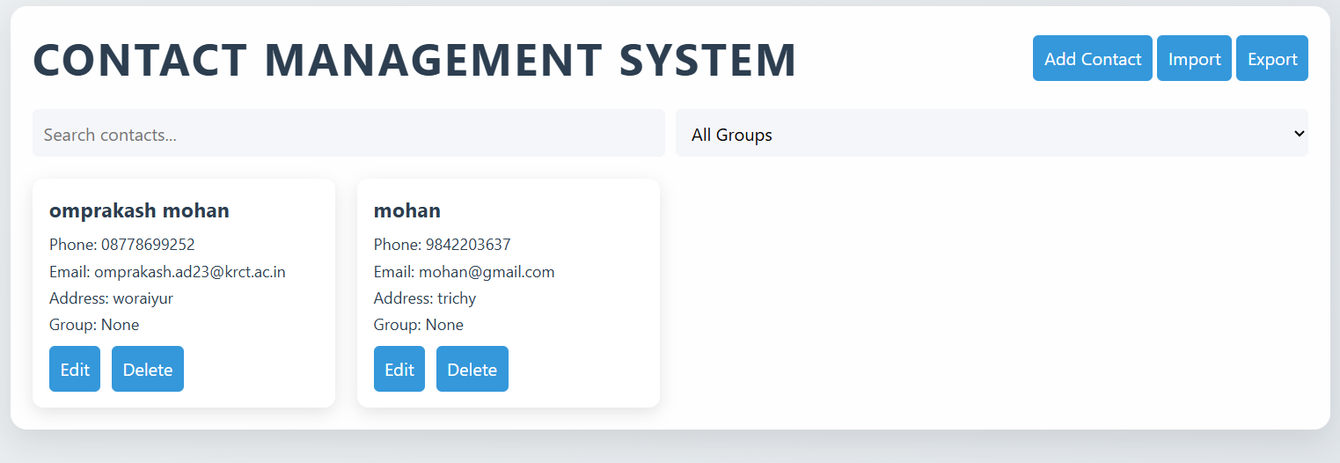
MODULES DESCRIPTION
User Interface Module: This module consists of a graphical interface where users can add, view, update, and delete contacts. It facilitates easy navigation and interaction with the system

Slide 10
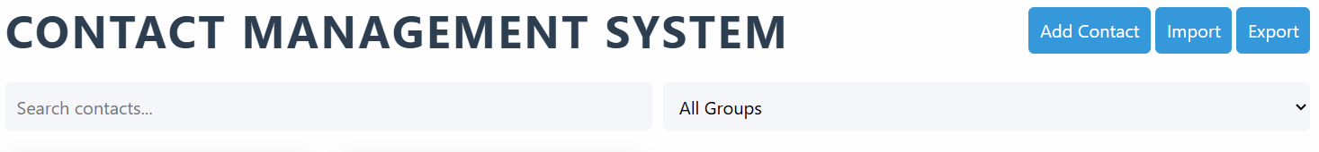
MODULES DESCRIPTION
Search and Sorting Module: This module enables users to search for contacts by specific criteria, such as name or phone number, and sort the results in ascending or descending order.

Slide 11
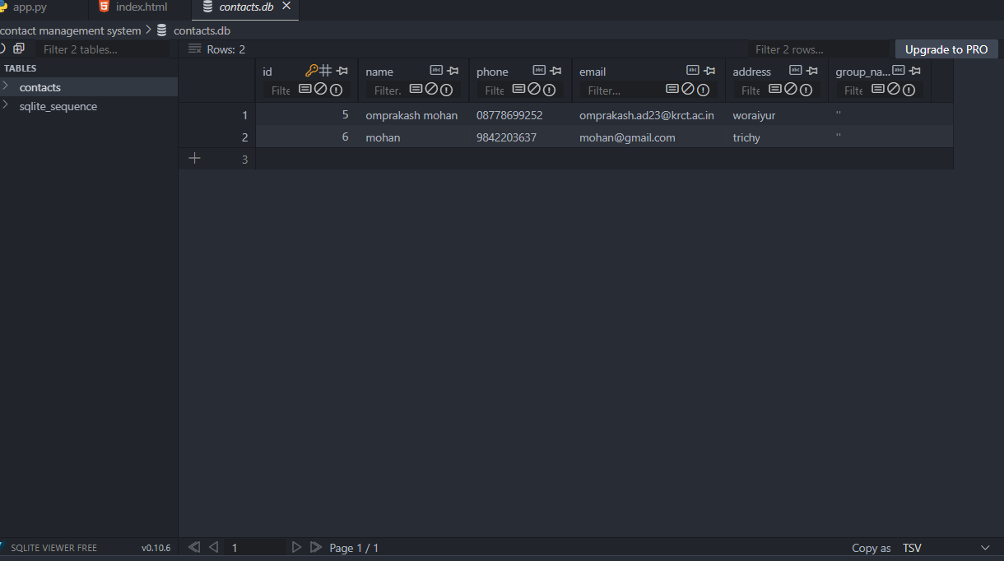
MODULES DESCRIPTION
Database Management Module: This module handles all database-related operations, ensuring data is stored, retrieved, and updated correctly. It uses SQL queries to interact with the database.

Slide 12
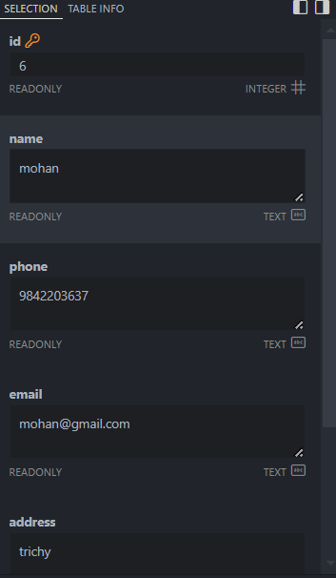
Admin Module:
The Admin Module manages system-wide operations, such as user management, data security, and overall system performance.

Slide 13
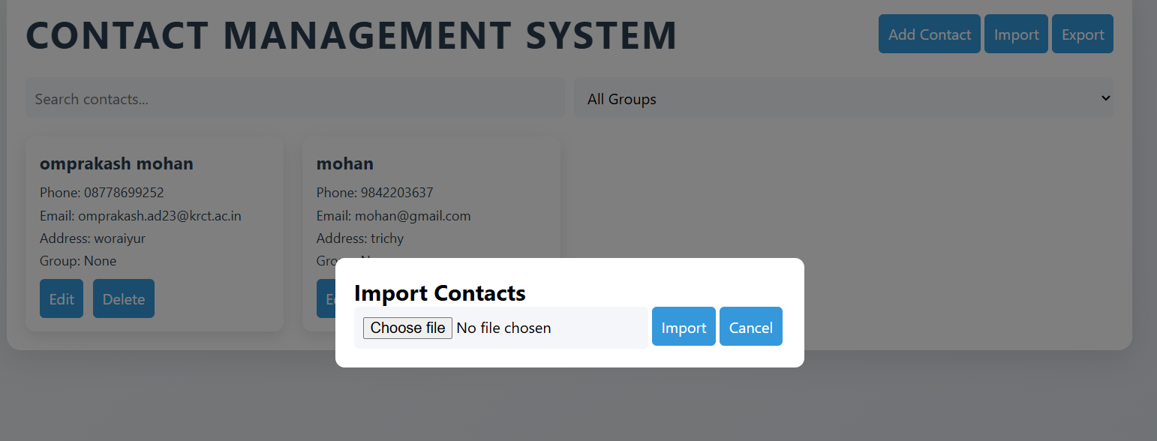
Import Module:
The Import Module allows users to import contact information from external sources such as
CSV, Excel, or JSON files. This helps in bulk uploading contacts quickly and efficiently without manual entry.

Slide 14
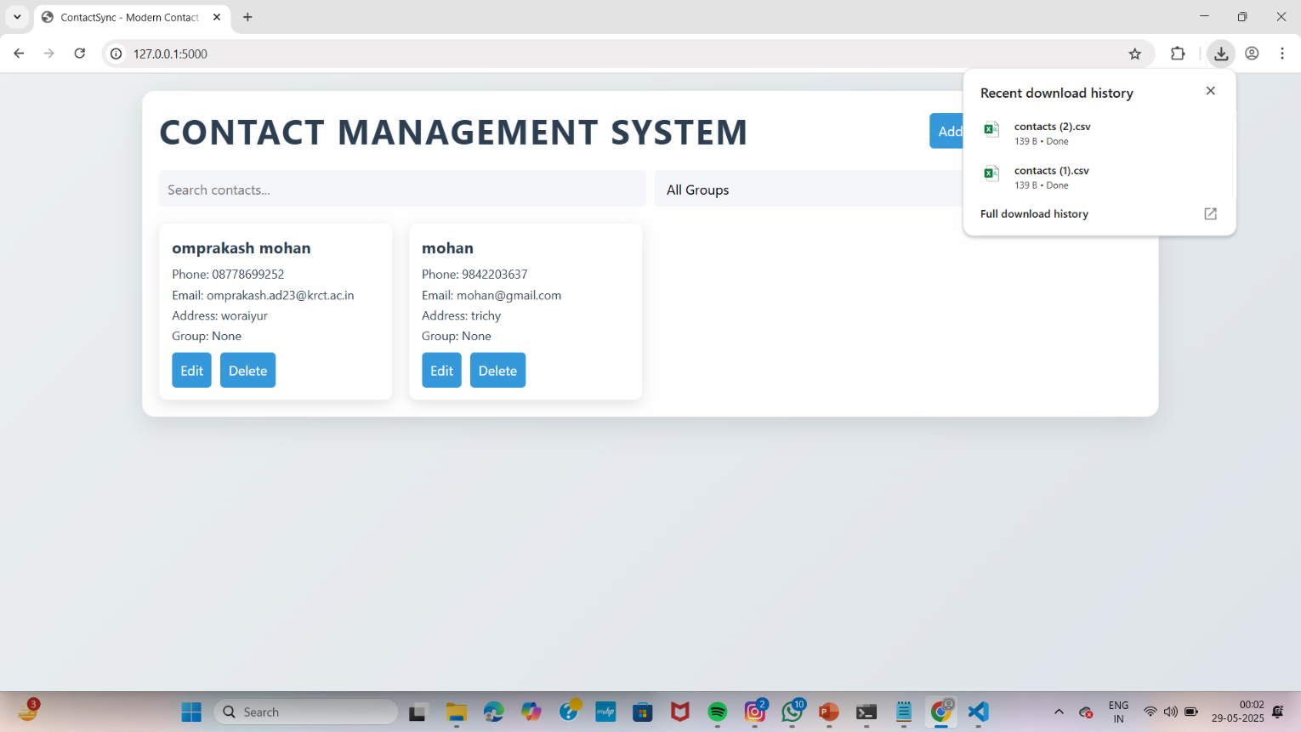
Export Module:
The Export Module enables users to export contact data into various formats like
CSV, PDF, or Excel. This feature helps in creating backups or sharing contacts with others.

Slide 15
CONCLUSION
The Contact Management System provides an effective solution for managing contact information in an organized and secure manner. By implementing a centralized database, the system streamlines the process of storing, updating, and retrieving contact details, making it easier for users to stay organized. The inclusion of advanced features like search, sorting, and notification systems enhances user experience and efficiency. The system ensures data security through user authentication and access control, protecting sensitive information.

Slide 16
THANK YOU…

